Slide 1


Noida Institute of Engineering and Technology, Greater Noida
Operating System
ACSE0403A
Unit: 3
Deadlock and Concurrent Processing
Aditya Narayan Singh
Assistant Professor
Department of CSE
B Tech 4th Sem
Aditya Narayan Singh ACSE0403A OS Unit-3

Slide 2
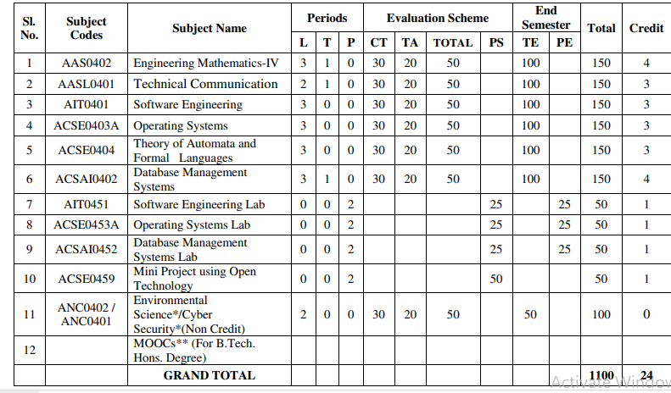
Evaluation Scheme
Aditya Narayan Singh ACSE0403A OS Unit-3

Slide 3
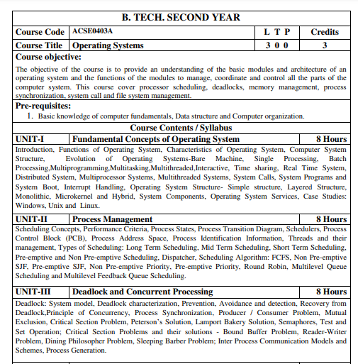
Subject Syllabus
Aditya Narayan Singh ACSE0403A OS Unit-3

Slide 4
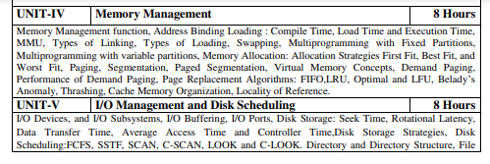

Subject Syllabus
Aditya Narayan Singh ACSE0403A OS Unit-3

Slide 5
Syllabus For Unit-3
UNIT-III Deadlock and Concurrent Processing
Deadlock: System model, Deadlock characterization, Prevention, Avoidance and detection, Recovery from Deadlock, Principle of Concurrency, Process Synchronization, Producer / Consumer Problem, Mutual Exclusion, Critical Section Problem, Peterson’s Solution, Lamport Bakery Solution, Semaphores, Test and Set Operation; Critical Section Problems and their solutions - Bound Buffer Problem, Reader-Writer Problem, Dining Philosopher Problem, Sleeping Barber Problem; Inter Process Communication Models and Schemes, Process Generation.
Aditya Narayan Singh ACSE0403A OS Unit-3

Slide 6
Branch wise Applications
Airlines reservation system.
Air traffic control system.
Systems that provide immediate updating.
Used in any system that provides up to date and minute
information on stock prices.
Defense application systems like RADAR.
Networked Multimedia Systems.
Command Control Systems.
Aditya Narayan Singh ACSE0403A OS Unit-3

Slide 7
Course Objectives
Provide an understanding of the basic modules and architecture of an operating system and the functions of the modules to manage, coordinate and control all the parts of the
computer system.
Processor scheduling, deadlocks, memory management, process synchronization, system call and file system management.
Aditya Narayan Singh ACSE0403A OS Unit-3

Slide 8
Course Outcomes
Course outcome: After completion of this course students will be able to:
CO 1 | Understand the fundamentals of an operating systems, functions and their structure and functions. | K1, K2
CO2 | Implement concept of process management policies, CPU Scheduling and thread management. | K5
CO3 | Understand and implement the requirement of process synchronization and apply deadlock handling algorithms. | K2,K5
CO4 | Evaluate the memory management and its allocation policies. | K5
CO5 | Understand and analyze the I/O management and File systems | K2, K4
Aditya Narayan Singh ACSE0403A OS Unit-3

Slide 9
Program Outcomes
1. Engineering knowledge
2. Problem analysis
3. Design/development of solutions
4.Conduct investigations of complex problems
5. Modern tool usage
6. The engineer and society
7. Environment and sustainability
8. Ethics:
9. Individual and team work
10. Communication
11. Project management and finance
12. Life-long learning
Aditya Narayan Singh ACSE0403A OS Unit-3

Slide 10
COs and POs Mapping
OPERATING SYSTEM (ACSE0403A )
CODE | PO1 | PO2 | PO3 | PO4 | PO5 | PO6 | PO7 | PO8 | PO9 | PO10 | PO11 | PO12
ACSE0403A .1 | 3 | 3 | 2 | 2 | 1 | 2 | - | 2 | 3 | 2 | 2 | 3
ACSE0403A .2 | 3 | 3 | 3 | 2 | 2 | 3 | - | 2 | 3 | 1 | 1 | 3
ACSE0403A .3 | 3 | 3 | 2 | 2 | 2 | 2 | - | 2 | 2 | 3 | 1 | 3
ACSE0403A .4 | 3 | 2 | 2 | 3 | 1 | 2 | - | 1 | 2 | 1 | 2 | 3
ACSE0403A .5 | 3 | 1 | 2 | 2 | 2 | 2 | - | 1 | 2 | 2 | 2 | 3
Average | 3 | 2.4 | 2.2 | 2.2 | 1.6 | 2.2 | - | 1.8 | 2.2 | 1.8 | 1.6 | 3
Aditya Narayan Singh ACSE0403A OS Unit-3

Slide 11
Program Specific Outcomes(PSOs)
On successful completion of B. Tech. (I.T.) Program, the Information Technology graduates will be able to:
PSO1:- Work as a software developer, database administrator, tester or networking engineer for providing solutions to the real world and industrial problems.
PSO2:- Apply core subjects of information technology related to data structure and algorithm, software engineering, web technology, operating system, database and networking to solve complex IT problems.
PSO3:-Practice multi-disciplinary and modern computing techniques by lifelong learning to establish innovative career.
PSO4:-Work in a team or individual to manage projects with ethical concern to be a successful employee or employer in IT industry.
Aditya Narayan Singh ACSE0403A OS Unit-3

Slide 12
COs and PSOs Mapping
Course Outcomes | Program Specific Outcomes
 | PSO1 | PSO2 | PSO3 | PSO4
ACSE0403A .1 | 2 | 1 | 2 | 2
ACSE0403A .2 | 2 | 2 | 1 | 2
ACSE0403A .3 | 2 | 3 | 3 | 2
ACSE0403A .4 | 2 | 2 | 1 | 2
ACSE0403A .5 | 2 | 2 | 2 | 2
Average | 2 | 2 | 1.8 | 2
Aditya Narayan Singh ACSE0403A OS Unit-3

Slide 13
Program Educational Objectives (PEOs)
PEO1:Apply sound knowledge in the field of information technology to fulfill the needs of IT industry.
PEO2:Design innovative and interdisciplinary systems through latest digital technologies.
PEO3:Inculcate professional – social ethics, team work and leadership for serving the society.
PEO4:Inculcate lifelong learning in the field of computing for successful career in organizations and R&D sectors.
Aditya Narayan Singh ACSE0403A OS Unit-3

Slide 14
Faculty wise Result Analysis
Semester & Section | Subject Code | Result
Aditya Narayan Singh ACSE0403A OS Unit-3

Slide 15
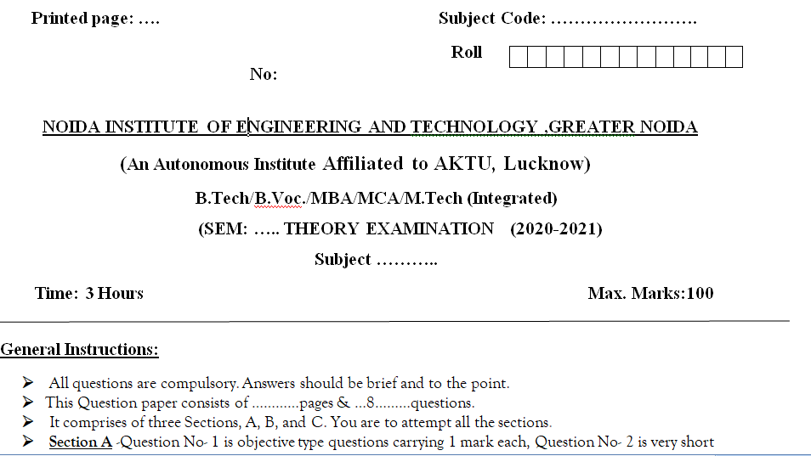
End Semester Question Paper Templates (Offline Pattern/Online Pattern
Aditya Narayan Singh ACSE0403A OS Unit-3

Slide 16
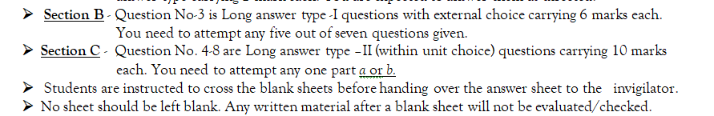
End Semester Question Paper Templates (Offline Pattern/Online Pattern
Aditya Narayan Singh ACSE0403A OS Unit-3

Slide 17

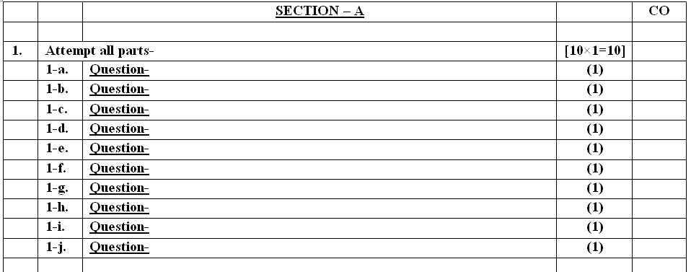
End Semester Question Paper Templates (Offline Pattern/Online Pattern
Aditya Narayan Singh ACSE0403A OS Unit-3

Slide 18
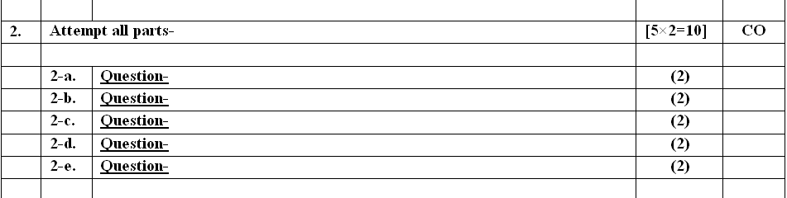
End Semester Question Paper Templates (Offline Pattern/Online Pattern
Aditya Narayan Singh ACSE0403A OS Unit-3

Slide 19
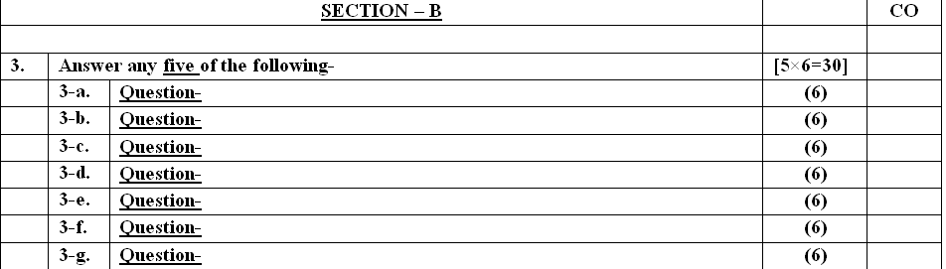
End Semester Question Paper Templates (Offline Pattern/Online Pattern
Aditya Narayan Singh ACSE0403A OS Unit-3

Slide 20
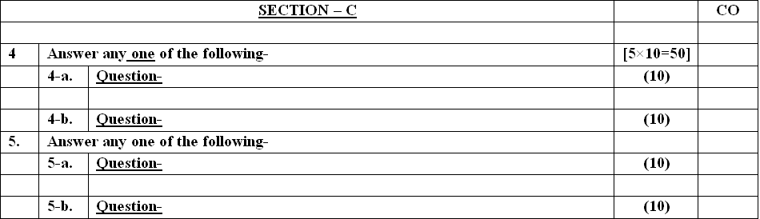
End Semester Question Paper Templates (Offline Pattern/Online Pattern
Aditya Narayan Singh ACSE0403A OS Unit-3

Slide 21

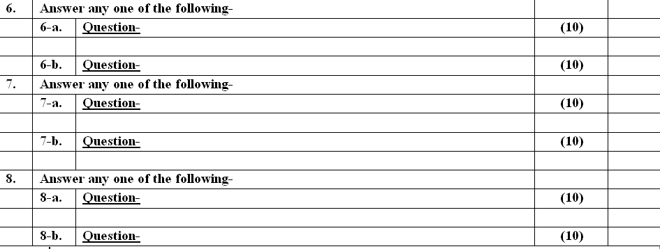
End Semester Question Paper Templates (Offline Pattern/Online Pattern
Aditya Narayan Singh ACSE0403A OS Unit-3

Slide 22
Prerequisite and Recap
Prerequisite
First get your computer hardware basics cleared.
Digital logic and it’s design (Basics will make understand storing memory and page faults, Difference between ram and rom. etc.,)
Computer Organization and Architecture( Design of Computer architecture will help you understand computer peripherals and its storages, accessing them in operating system )
Strong programming skills (Knowledge of C).
Recap
To Understood the concept of process and process state
To understood and analyze the various the of CPU Scheduling Algorithm
To Understood the concept thread and their uses
Aditya Narayan Singh ACSE0403A OS Unit-3

Slide 23
Objective of Unit -3
To develop a description of deadlocks, which prevent sets of concurrent processes from completing their tasks.
To present a number of different methods for preventing or avoiding deadlocks in a computer system.
To describe the various features of processes, including scheduling, creation, and termination.
To explore interprocess communication using shared memory and message passing.
To describe communication in client-server systems.
To introduce the critical-section problem, whose solutions can be used to ensure the consistency of shared data.
To present both software and hardware solutions of the critical-section problem.
To examine several classical process-synchronization problems.
Aditya Narayan Singh ACSE0403A OS Unit-3

Slide 24
Unit- Recap
To understand Processes and process state
To analyze the critical section problem with various algorithm
Illustrate the methods of process management, process synchronization.
Demonstrate the various classical problem implemented by semaphore
To understand the hardware synchronization and monitor
To understand of deadlocks, which prevent sets of concurrent processes from completing their tasks.
To understand different methods for preventing or avoiding deadlocks in a computer system.
Aditya Narayan Singh ACSE0403A OS Unit-3

Slide 25
Brief Introduction about the subject with video
An operating system acts as an intermediary between the user of a computer and computer hardware. The purpose of an operating system is to provide an environment in which a user can execute programs conveniently and efficiently
YouTube/other Video Links
https://www.youtube.com/playlist?list=PLmXKhU9FNesSFvj6gASuWmQd23Ul5omtD
Aditya Narayan Singh ACSE0403A OS Unit-3

Slide 26
Prerequisite and Recap
Basic knowledge of computer fundamentals.
Basic knowledge of computer organization.
Memory hierarchy
Cache Organization
Interrupt
Registers
Associative memory
Aditya Narayan Singh ACSE0403A OS Unit-3

Slide 27
Unit-3 Content
Deadlock
Deadlock characterization
Deadlock Prevention
Deadlock Avoidance
Recovery from Deadlock
Principle of Concurrency
Process Synchronization & it’s Problems
Mutual Exclusion
Aditya Narayan Singh ACSE0403A OS Unit-3

Slide 28
Unit-3 Content
Critical Section Problem
Peterson’s Solution
Lamport Bakery Solution
Semaphores
Test and Set Operation
Critical Section Problems and their solutions
Inter Process Communication Models and Schemes
Process Generation
Aditya Narayan Singh ACSE0403A OS Unit-3

Slide 29
Topic Objective
Deadlock | Understand the concept of Deadlock
Principle of Concurrency | Understand the concept of concurrent Processes
Process Synchronization | Understand the concept of Process Synchronization
Mutual Exclusion | Understand the concept of Mutual Exclusion
Semaphores | Understand the concept of Semaphore Solution
Critical Section | Understand the concept of Critical Section
Inter Process Communication | Understand the concept of IPC
Aditya Narayan Singh ACSE0403A OS Unit-3

Slide 30
Unit-3 Objective
  After going through this unit, you should be able to:
  Understand the concept of Deadlock.
  Understand the concept of Process Synchronization
  Understand the concept of Critical Section
  Understand the concept of Inter Process Communication
  Understand the concept of Process Generation
Aditya Narayan Singh ACSE0403A OS Unit-3

Slide 31
Topic mapping with CO
Deadlock (CO3)
Deadlock characterization (CO3)
Deadlock Prevention (CO3)
Deadlock Avoidance (CO3)
Recovery from Deadlock (CO3)
Principle of Concurrency (CO3)
Process Synchronization & it’s Problems (CO3)
Mutual Exclusion (CO3)
Aditya Narayan Singh ACSE0403A OS Unit-3

Slide 32
Topic mapping with CO
Critical Section Problem (CO3)
Peterson’s Solution (CO3)
Lamport Bakery Solution (CO3)
Semaphores (CO3)
Test and Set Operation (CO3)
Critical Section Problems and their solutions (CO3)
Inter Process Communication Models and Schemes (CO3)
Process Generation (CO3)
Aditya Narayan Singh ACSE0403A OS Unit-3

Slide 33
Deadlock(C03)
In a multiprogramming system, processes request resources. If those resources are being used by other processes then the process enters a waiting state. However, if other processes are also in a waiting state, we have deadlock.
A set of processes is in a deadlock state if every process in the set is waiting for an event (release) that can only be caused by some other process in the same set.
Example
-System has 2 disk drives
-P1 and P2 process each hold one disk drive and each needs another one
Aditya Narayan Singh ACSE0403A OS Unit-3

Slide 34
Deadlock Characterization(CO3)
Deadlock can arise if four conditions hold simultaneously
Mutual exclusion: only one process at a time can use a resource .
Hold and wait: a process holding at least one resource is waiting to acquire additional resources held by other processes .
No preemption: a resource can be released only voluntarily by the process holding it, after that process has completed its task .
Circular wait: there exists a set {P0, P1, …, Pn} of waiting processes such that P0 is waiting for a resource that is held by P1, P1 is waiting for a resource that is held by P2, …, Pn–1 is waiting for a resource that is held by Pn, and Pn is waiting for a resource that is held by P0.
Aditya Narayan Singh ACSE0403A OS Unit-3

Slide 35
Resource-Allocation Graph(CO3)
A resource allocation graph is a set of vertices V and a set of edges E such that:
V is partitioned into two types:
P = {P1, P2, …, Pn}, the set consisting of all the processes in the system
R = {R1, R2, …, Rm}, the set consisting of all resource types in the system
request edge – directed edge P_{i} → R_{j}
assignment edge – directed edge R_{j} → P_{i}
Aditya Narayan Singh ACSE0403A OS Unit-3

Slide 36



Resource-Allocation Graph(CO3)
Process
Resource Type with 4 instances
P_{i} requests instance of R_{j}
P_{i} is holding an instance of R_{j}
P_{i}
P_{i}
Aditya Narayan Singh ACSE0403A OS Unit-3

Slide 37


Resource Allocation Graph With A Deadlock(CO3)
Before P₃ requested an instance of R₂
After P₃ requested an instance of R₂
A Cycle In the Graph May cause Deadlock
Aditya Narayan Singh ACSE0403A OS Unit-3

Slide 38
Summary(CO3)
If graph contains no cycles ⇒ no deadlock
If graph contains a cycle ⇒
  if only one instance per resource type, then deadlock
  if several instances per resource type, possibility of deadlock
Aditya Narayan Singh ACSE0403A OS Unit-3

Slide 39
Methods for Handling Deadlocks(CO3)
Prevention
  Ensure that the system will never enter a deadlock state
Avoidance
  Ensure that the system will never enter an unsafe state
Detection
  Allow the system to enter a deadlock state and then recover
Do Nothing ( Ignorance )
  Ignore the problem and let the user or system administrator respond to the problem; used by most operating systems, including Windows and UNIX
Aditya Narayan Singh ACSE0403A OS Unit-3

Slide 40

Aditya Narayan Singh ACSE0403A OS Unit-3

Slide 41

Methods for Handling Deadlocks(CO3)
Aditya Narayan Singh ACSE0403A OS Unit-3

Slide 42
Deadlock Prevention(CO3)
      To prevent deadlock, we can restrain the ways that a request can be made
      Do not allow one of the four conditions to occur
      Mutual Exclusion :
if no resource were ever assigned to a single process exclusively ,we would never have deadlock.
  Shared entities (read only files) don't need mutual exclusion (and aren’t susceptible to deadlock.)
  Prevention not possible, since some devices are naturally non-sharable
Aditya Narayan Singh ACSE0403A OS Unit-3

Slide 43
Deadlock Prevention(CO3)
Hold And Wait :
we must guarantee that whenever a process requests a resource, it does not hold any other resources
  Require a process to request and be allocated all its resources before it begins execution
  allow a process to request resources only when the process has none
  Wait time out
  Result: Low resource utilization; starvation possible
Aditya Narayan Singh ACSE0403A OS Unit-3

Slide 44
Deadlock Prevention(CO3)
No Preemption :
  If a process that is holding some resources requests another resource that cannot be immediately allocated to it, then all resources currently being held are released
  Pi → Rj → Pj → Rk
  A process will be restarted only when it can regain its old resources, as well as the new ones that it is requesting.
  Allow preemption - if a needed resource is held by another process, which is also waiting on some resource, steal it. Otherwise wait.
  Circular Wait :
  Impose a total ordering of all resource types, and require that each process requests resources in an increasing order of enumeration.
Aditya Narayan Singh ACSE0403A OS Unit-3

Slide 45
Deadlock Avoidance(CO3)
Requires that the system has some additional a priori information available
Simplest and most useful model requires that each process declare the maximum number of resources of each type that it may need
The deadlock-avoidance algorithm dynamically examines the resource-allocation state to ensure that there can never be a circular-wait condition
Resource-allocation state is defined by the number of available and allocated resources, and the maximum demands of the processes
Aditya Narayan Singh ACSE0403A OS Unit-3

Slide 46
Safe State(CO3)
When a process requests an available resource, system must decide if immediate allocation leaves the system in a safe state
System is in safe state if there exists a sequence <P₁, P₂, …, P_{n}> of all the processes in the systems such that for each P_{i}, the resources that P_{i} can still request can be satisfied by currently available resources + resources held by all the P_{j}, with j < i
That is:
  If P_{i} resource needs are not immediately available, then P_{i} can wait until all P_{j} have finished
  When P_{j} is finished, P_{i} can obtain needed resources, execute, return allocated resources, and terminate
  When P_{i} terminates, P_{i +1} can obtain its needed resources, and so on
Aditya Narayan Singh ACSE0403A OS Unit-3

Slide 47
Safe State(CO3)
If a system is in safe state ⇒ no deadlocks
If a system is in unsafe state ⇒ possibility of deadlock
Avoidance ⇒ ensure that a system will never enter an unsafe state.
Aditya Narayan Singh ACSE0403A OS Unit-3

Slide 48

Safe State(CO3)
Aditya Narayan Singh ACSE0403A OS Unit-3

Slide 49
Avoidance algorithms(CO3)
For a single instance of a resource type, use a resource-allocation graph
For multiple instances of a resource type, use the banker’s algorithm
Aditya Narayan Singh ACSE0403A OS Unit-3

Slide 50

Resource-Allocation Graph with Claim Edges(CO3)
Assignment
edge
Request
edge
Claim
edge
Claim
edge
Aditya Narayan Singh ACSE0403A OS Unit-3

Slide 51

Unsafe State In Resource-Allocation Graph (CO3)
Assignment
edge
Request
edge
Assignment
edge
Claim
edge
Aditya Narayan Singh ACSE0403A OS Unit-3

Slide 52
Resource-Allocation Graph Algorithm(CO3)
Suppose that process P_{i} requests a resource R_{j}
The request can be granted only if converting the request edge to an assignment edge does not result in the formation of a cycle in the resource allocation graph
Aditya Narayan Singh ACSE0403A OS Unit-3

Slide 53
Banker’s Algorithm(CO3)
Multiple instances
Each process must a priori claim maximum use
When a process requests a resource it may have to wait
When a process gets all its resources it must return them in a finite amount of time
Aditya Narayan Singh ACSE0403A OS Unit-3

Slide 54
Data Structures for the Banker’s Algorithm (CO3)
Let n = number of processes, and m = number of resources types.
Available: Vector of length m. If available [j] = k, there are k instances of resource type R_{j} available.
Max: n x m matrix. If Max [i,j] = k, then process P_{i} may request at most k instances of resource type R_{j}.
Allocation: n x m matrix. If Allocation[i,j] = k then P_{i} is currently allocated k instances of R_{j.}
Need: n x m matrix. If Need[i,j] = k, then P_{i} may need k more instances of R_{j} to complete its task.
Aditya Narayan Singh ACSE0403A OS Unit-3

Slide 55
Safety Algorithm(CO3)
1.Let Work and Finish be vectors of length m and n, respectively.
Initialize:
Work = Available
Finish [i] = false for i = 0, 1, …, n- 1
2.Find an i such that both:
  (a) Finish [i] = false
  (b) Need_{i} ≤ Work
  If no such i exists, go to step 4
3. Work = Work + Allocation_{i}
Finish[i] = true
go to step 2
4.If Finish [i] == true for all i, then the system is in a safe state
Aditya Narayan Singh ACSE0403A OS Unit-3

Slide 56
Resource-Request Algorithm for Process P_{i}(CO3)
Request_{i} = request vector for process P_{i}. If Request_{i} [j] = k then process P_{i} wants k instances of resource type R_{j}
  1. If Request_{i} ≤ Need_{i} go to step 2. Otherwise, raise error condition, since process has exceeded its maximum claim
  2. If Request_{i} ≤ Available, go to step 3. Otherwise P_{i} must wait, since resources are not available
  3. Pretend to allocate requested resources to P_{i} by modifying the state as follows:
      Available = Available – Request_{i};
      Allocation_{i} = Allocation_{i} + Request_{i};
      Need_{i} = Need_{i} – Request_{i};
    If safe ⇒ the resources are allocated to P_{i}
    If unsafe ⇒ P_{i} must wait, and the old resource-allocation state is restored
Aditya Narayan Singh ACSE0403A OS Unit-3

Slide 57
Example of Banker’s Algorithm(CO3)
5 processes P₀ through P₄;
3 resource types:
A (10 instances), B (5 instances), and C (7 instances)
Snapshot at time T₀:
Allocation Max Available
A B C A B C A B C
P₀ 0 1 0 7 5 3 3 3 2
P₁ 2 0 0 3 2 2
P₂ 3 0 2 9 0 2
P₃ 2 1 1 2 2 2
P₄ 0 0 2 4 3 3
Aditya Narayan Singh ACSE0403A OS Unit-3

Slide 58
Example (Cont.)(CO3)
The content of the matrix Need is defined to be Max – Allocation
Need
A B C
P₀ 7 4 3
P₁ 1 2 2
P₂ 6 0 0
P₃ 0 1 1
P₄ 4 3 1
The system is in a safe state since the sequence < P₁, P₃, P₄, P₂, P₀> satisfies safety criteria
Aditya Narayan Singh ACSE0403A OS Unit-3

Slide 59
Example: (CO3)
P₁ Request (1,0,2)
Check that Request ≤ Available (that is, (1,0,2) ≤ (3,3,2) ⇒ true
Allocation Need Available
A B C A B C A B C
P₀ 0 1 0 7 4 3 2 3 0
P₁ 3 0 2 0 2 0
P₂ 3 0 2 6 0 0
P₃ 2 1 1 0 1 1
P₄ 0 0 2 4 3 1
Executing safety algorithm shows that sequence < P₁, P₃, P₄, P₀, P₂> satisfies safety requirement
Aditya Narayan Singh ACSE0403A OS Unit-3

Slide 60
Deadlock Detection(CO3)
Allow system to enter deadlock state
Detection algorithm
Recovery scheme
Aditya Narayan Singh ACSE0403A OS Unit-3

Slide 61
Single Instance of Each Resource Type(CO3)
Maintain wait-for graph
  Nodes are processes
  P_{i} → P_{j} if P_{i} is waiting for P_{j}
Periodically invoke an algorithm that searches for a cycle in the graph. If there is a cycle, there exists a deadlock
An algorithm to detect a cycle in a graph requires an order of n² operations, where n is the number of vertices in the graph
Aditya Narayan Singh ACSE0403A OS Unit-3

Slide 62

Single Instance of Each Resource Type(CO3)
Resource-Allocation Graph
Corresponding wait-for graph
Aditya Narayan Singh ACSE0403A OS Unit-3

Slide 63
Several Instances of a Resource Type(CO3)
Available: A vector of length m indicates the number of available resources of each type
Allocation: An n x m matrix defines the number of resources of each type currently allocated to each process
Request: An n x m matrix indicates the current request of each process. If Request [i][j] = k, then process P_{i} is requesting k more instances of resource type R_{j}.
Aditya Narayan Singh ACSE0403A OS Unit-3

Slide 64
Detection Algorithm(CO3)
1. Let Work and Finish be vectors of length m and n, respectively Initialize:
  (a) Work = Available
  For i = 1,2, …, n, if Allocation_{i} ≠ 0, then
  Finish[i] = false; otherwise, Finish[i] = true
2. Find an index i such that both:
  (a) Finish[i] == false
  Request_{i} ≤ Work
  If no such i exists, go to step 4
3. Work = Work + Allocation_{i}
Finish[i] = true
go to step 2
4. If Finish[i] == false, for some i, 1 ≤ i ≤ n, then the system is in deadlock state. Moreover, if Finish[i] == false, then P_{i} is deadlocked
Aditya Narayan Singh ACSE0403A OS Unit-3

Slide 65
Recovery from Deadlock(CO3)
Process Termination :
Abort all deadlocked processes
Abort one process at a time until the deadlock cycle is eliminated
In which order should we choose to abort?
  Priority of the process
  How long process has computed, and how much longer to completion
  Resources the process has used
  Resources process needs to complete
  How many processes will need to be terminated
  Is process interactive or batch?
Aditya Narayan Singh ACSE0403A OS Unit-3

Slide 66
Recovery from Deadlock(CO3)
Resource Preemption :
Selecting a victim – minimize cost
Rollback – return to some safe state, restart process for that state
Starvation – same process may always be picked as victim, include number of rollback in cost factor
Aditya Narayan Singh ACSE0403A OS Unit-3

Slide 67
Cooperating Processes(CO3)
Independent process cannot affect or be affected by the execution of another process
Cooperating process can affect or be affected by the execution of another process
Advantages of process cooperation
  Information sharing
  Computation speed-up
  Modularity
  Convenience
Aditya Narayan Singh ACSE0403A OS Unit-3

Slide 68
Producer-Consumer Problem(CO3)
Unbounded-buffer places no practical limit on the size of buffer.
Bounded-buffer assumes that there is a fixed buffer size.
Producer code
while (true) {
/* produce an item in next produced */
while (counter == BUFFER_ SIZE) ;
/* do nothing */
buffer[in] = next_produced;
in = (in + 1) %BUFFER_SIZE;
counter++;
}
Aditya Narayan Singh ACSE0403A OS Unit-3

Slide 69
Producer-Consumer Problem(CO3)
Consumer code
while (true) {
while (counter == 0);
/* do nothing */
next_consumed = buffer[out];
out = (out + 1) % BUFFER_SIZE;
counter--;
/* consume the item in next consumed */
}
Aditya Narayan Singh ACSE0403A OS Unit-3

Slide 70
Race Condition(CO3)
counter++ could be implemented as
register1 = counter
register1 = register1 + 1
counter = register1
counter-- could be implemented as
register2 = counter
register2 = register2 - 1
counter = register2
Consider this execution interleaving with “count = 5” initially:
S0: producer execute register1 = counter {register1 = 5}
S1: producer execute register1 = register1 + 1 {register1 = 6}
S2: consumer execute register2 = counter {register2= 5}
S3: consumer execute register2 = register2 – 1{register2 = 4}
S4: producer execute counter = register1 {counter = 6}
S5: consumer execute counter = register2 {counter = 4}
Aditya Narayan Singh ACSE0403A OS Unit-3

Slide 71
Critical Section Problem(CO3)
Consider system of n processes {p₀, p₁, … p_{n-1}}
Each process has critical section segment of code
  Process may be changing common variables, updating table, writing file, etc
  When one process in critical section, no other may be in its critical section
Critical section problem is to design protocol to solve this
Each process must ask permission to enter critical section in entry section, may follow critical section with exit section, then remainder section
Aditya Narayan Singh ACSE0403A OS Unit-3

Slide 72
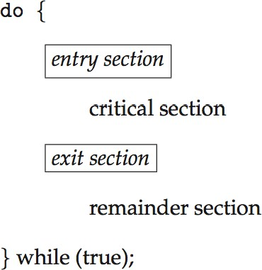
Critical Section(CO3)
General structure of process P_{i}
Aditya Narayan Singh ACSE0403A OS Unit-3
Operating System Concepts

Slide 73
Algorithm for Process P_{i}(CO3)
do {
while (turn == j);
critical section
turn = j;
remainder section
} while (true);
Aditya Narayan Singh ACSE0403A OS Unit-3

Slide 74
Solution to Critical-Section Problem(CO3)
Mutual Exclusion - If process P_{i} is executing in its critical section, then no other processes can be executing in their critical sections
Progress - If no process is executing in its critical section and there exist some processes that wish to enter their critical section, then the selection of the processes that will enter the critical section next cannot be postponed indefinitely
Bounded Waiting -A bound must exist on the number of times that other processes are allowed to enter their critical sections after a process has made a request to enter its critical section and before that request is granted
Aditya Narayan Singh ACSE0403A OS Unit-3

Slide 75
Peterson’s Solution(CO3)
S/W mechanism at user mode.
2 Process solution (P0, P1)
Busy waiting solution
It Uses (Turn + Interested ) variable
Aditya Narayan Singh ACSE0403A OS Unit-3
Operating System Concepts

Slide 76
Algorithm for Process P_{i}(CO3)
#define N 2
#define True 1
#define False 0
int interested [N] = False;
int turn;
Void Entry_Section( int process)
{
1) int other;
2) other = 1 – process;
3) interested [process] = True;
4) turn = process;
5) while( interested [other] == True &&
turn =process);
}
void Exit_section( int process)
{
6) interested [process] = False;
}
Aditya Narayan Singh ACSE0403A OS Unit-3
Operating System Concepts

Slide 77
Algorithm for Process P_{i}(CO3)
#define N 2
#define True 1
#define False 0
int interested [N] = False;
int turn;
Void Entry_Section( int process)
{
1) int other;
2) other = 1 – process;
3) interested [process] = True;
4) turn = process;
5) while( interested [other] == True && turn = process);
}
void Exit_section( int process)
{
6) interested [process] = False;
}
Aditya Narayan Singh ACSE0403A OS Unit-3
Operating System Concepts

Slide 78
Peterson’s Solution(CO3)
Good algorithmic description of solving the problem
Two process solution
The two processes share two variables:
  int turn;
  Boolean flag[2]
The variable turn indicates whose turn it is to enter the critical section
The flag array is used to indicate if a process is ready to enter the critical section. flag[i] = true implies that process P_{i} is ready!
Aditya Narayan Singh ACSE0403A OS Unit-3
Operating System Concepts

Slide 79
Algorithm for Process P_{i}(CO3)
do{
flag[i] = true;
turn = j;
while (flag[j] && turn = = j);
critical section
flag[i] = false;
remainder section
} while (true);
Provable that the three CS requirement are met:
  Mutual exclusion is preserved
P_{i} enters CS only if:
either flag[j] = false or turn = i
  Progress requirement is satisfied
  Bounded-waiting requirement is met
Aditya Narayan Singh ACSE0403A OS Unit-3

Slide 80
Semaphore(CO3)
Synchronization tool that provides more sophisticated ways for process to synchronize their activities.
Variables on which read, modify and update happens atomically in kernel mode (no preemption)
Semaphore S – integer variable
Can only be accessed via two indivisible (atomic) operations
  wait() and signal()
  Definition of the wait()operation
wait(S) {
while (S <= 0)
; // busy wait S--;
}
Definition of the signal() operation signal(S) {
S++;
}
Aditya Narayan Singh ACSE0403A OS Unit-3

Slide 81
Semaphore Usage(CO3)
Counting semaphore – integer value can range over an unrestricted domain ( - infinity to + infinity)
Binary semaphore – integer value can range only between 0 and 1
Can solve various synchronization problems
Consider P₁ and P₂ that require S₁ to happen before S₂
Create a semaphore “synch” initialized to 0
P1:
S₁;
signal(synch); P2:
wait(synch); S₂;
Can implement a counting semaphore S as a binary semaphore
Aditya Narayan Singh ACSE0403A OS Unit-3
Operating System Concets

Slide 82
Semaphore Implementation(CO3)
Must guarantee that no two processes can execute the wait()and signal() on the same semaphore at the same time
Thus, the implementation becomes the critical section problem where the wait and signal code are placed in the critical section
  Could now have busy waiting in critical section implementation
    But implementation code is short
    Little busy waiting if critical section rarely occupied
Note that applications may spend lots of time in critical sections and therefore this is not a good solution
Aditya Narayan Singh ACSE0403A OS Unit-3

Slide 83
Semaphore Implementation(CO3)
Decrement Increment
wait() signal()
Down() Up()
P V
Aditya Narayan Singh ACSE0403A OS Unit-3

Slide 84
Semaphore Implementation(CO3)
Counting Semaphore:
Struct Semaphore
{
Int value;
Queue type L;
}
Down(Semaphore S)
{
S.value = S.value -1;
If (S.value < 0)
{
put process (PCB) in L;
Sleep();
}
Else
Return;
}
UP(Semaphor S)
{
S.Value = S.value + 1;
If(S.value <= 0)
{
select a process from L;
wake up();
}
}
Aditya Narayan Singh ACSE0403A OS Unit-3

Slide 85
Semaphore Implementation(CO3)
Binary Semaphore:
Struct BSemaphore
{
enum value(0, 1);
Queue type L;
//L contains all PCBs corresponding to processes got blocked while performing down operation unsuccessfully.
}
Down(BSemaphore S)
{
If (S.value == 1)
{
S.value = 0;
}
Else
{
Put the process (PCB) in S.L;
Sleep();
}
}
Aditya Narayan Singh ACSE0403A OS Unit-3

Slide 86
Semaphore Implementation(CO3)
Binary Semaphore:
UP(BSemaphor S)
{
If (S.L is empty)
{
S.value = 1;
}
else
{
select a process from S.L;
wake up();
}
}
Down(BSemaphore S)
{
If (S.value == 1)
{
S.value = 0;
}
Else
{
Put the process (PCB) in S.L;
Sleep();
}
}
Aditya Narayan Singh ACSE0403A OS Unit-3

Slide 87
Classical Problems of Synchronization(CO3)
Classical problems used to test newly-proposed synchronization schemes
  Bounded-Buffer Problem
  Readers and Writers Problem
  Dining-Philosophers Problem
Aditya Narayan Singh ACSE0403A OS Unit-3

Slide 88
Bounded-Buffer Problem(CO3)
n buffers, each can hold one item
Semaphore mutex initialized to the value 1
Semaphore full initialized to the value 0
Semaphore empty initialized to the value n
Aditya Narayan Singh ACSE0403A OS Unit-3

Slide 89
Bounded Buffer Problem (Cont.) (CO3)
Counting Semaphor :
Full=0 // no. of filled slots
Empty = N // No. of empty slots
Binary Semaphor S=1;
Produce_item ( item p)
{
1) Down (empty);
2) Down (S);
Buffer[in] = itemp; // CS
In = (in + 1) mod n; // CS
3) Up(S);
4) Up(full);
}
Consumer_item ( item p)
{
1) Down (full);
2) Down (S);
item C = Buffer [out] ; // CS
out = (out + 1) mod n; // CS
3) Up(S);
4) Up(empty);
}
Aditya Narayan Singh ACSE0403A OS Unit-3

Slide 90
Bounded Buffer Problem (Cont.) (CO3)
The structure of the producer process
do {
...
/* produce an item in next_produced */
...
wait(empty); wait(mutex);
...
/* add next produced to the buffer */
...
signal(mutex); signal(full);
}while(true);
Aditya Narayan Singh ACSE0403A OS Unit-3

Slide 91
Bounded Buffer Problem (Cont.) (CO3)
The structure of the consumer process
do {
wait(full); wait(mutex);
...
/* remove an item from buffer to next_consumed */
...
signal(mutex); signal(empty);
...
/* consume the item in next consumed */
...
}while(true);
Aditya Narayan Singh ACSE0403A OS Unit-3

Slide 92
Readers-Writers Problem(CO3)
A data set is shared among a number of concurrent processes
  Readers – only read the data set; they do not perform any updates
  Writers – can both read and write
Problem – allow multiple readers to read at the same time
  Only one single writer can access the shared data at the same time
Several variations of how readers and writers are considered -all involve some form of priorities
Shared Data
  Data set
  Semaphore rw_mutex initialized to 1
  Semaphore mutex initialized to 1
  Integer read_count initialized to 0
Aditya Narayan Singh ACSE0403A OS Unit-3

Slide 93
Readers-Writers Problem(CO3)
Problem –
R --- W
W---- R
W---- W
No Problem
R----R
Aditya Narayan Singh ACSE0403A OS Unit-3

Slide 94
Readers-Writers Problem(CO3)
int rc = 0; // Read Count
// No. of readers in the Buffer
Semaphor mutex =1;
Semaphor db =1;
Void Reader (void)
{
While (true)
{
Down (mutex);
rc = rc + 1;
If (rc ==1) then down(db);
Up(mutex);
DB // CS
Down (mutex)
rc = rc -1;
If (rc==0) then up(db);
Up (mutex);
Process_data;
}
}
Void writer (void)
{
While (true)
{
down (db);
DB // Critical Section (CS)
Up (db);
}
}
Aditya Narayan Singh ACSE0403A OS Unit-3

Slide 95
Readers-Writers Problem (Cont.) (CO3)
The structure of a writer process
Do
{
wait(rw_mutex);
...
/* writing is performed */
...
signal(rw_mutex);
}
while (true);
Aditya Narayan Singh ACSE0403A OS Unit-3

Slide 96
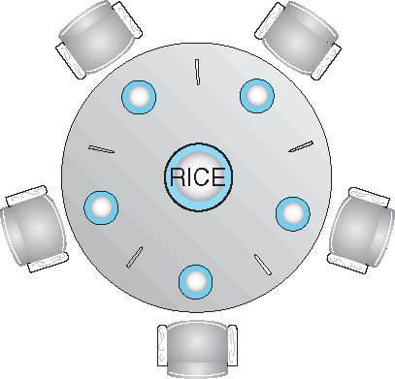
Dining-Philosophers Problem(CO3)
Aditya Narayan Singh ACSE0403A OS Unit-3

Slide 97
Dining-Philosophers Problem(CO3)
Philosophers spend their lives alternating thinking and eating
Don’t interact with their neighbors, occasionally try to pick up 2 chopsticks (one at a time) to eat from bowl
  Need both to eat, then release both when done
In the case of 5 philosophers
  Shared data
    Bowl of rice (data set)
    Semaphore chopstick [5] initialized to 1
Aditya Narayan Singh ACSE0403A OS Unit-3

Slide 98
Dining-Philosophers Problem Algorithm(CO3)
Void Philosopher (void)
{
While (true)
{
Thinking();
Take_ chopstick[i] ;// left
Take_ chopstick[(i+1)mod N] ;//right , N= no. of chopstick(5)
Eat();
put_ chopstick[i] ;
put_ chopstick[(i+1)/N]
}
}
Aditya Narayan Singh ACSE0403A OS Unit-3

Slide 99
Dining-Philosophers Problem Algorithm(CO3)
Void Philosopher (void)
{
While (true)
{
Thinking();
Wait(Take_ chopstick[Si] );// left
Wait(Take_chopstick[S(i+1)modN]) ;//right , N= no. of chopstick(5)
Eat();
Signal(put_ chopstick[Si]) ;
Signal(put_chopstick[S(i+1)modN]);
}
}
Aditya Narayan Singh ACSE0403A OS Unit-3

Slide 100
Dining-Philosophers Problem Algorithm(CO3)
Void Philosopher (void)
{
While (true)
{
Thinking();
For Nth process:
Wait(Take_chopstick[S(i+1)modN]) ;//right , N= no. of chopstick(5)
Wait(Take_ chopstick[Si] );// left
Eat();
Signal(put_ chopstick[Si]) ;
Signal(put_chopstick[S(i+1)modN]);
}
}
Aditya Narayan Singh ACSE0403A OS Unit-3

Slide 101
Dining-Philosophers Problem Algorithm(CO3)
The structure of Philosopher i:
do {
wait (chopstick[i] );
wait (chopStick[ (i + 1) % 5] );
// eat signal (chopstick[i] );
signal (chopstick[ (i + 1) % 5] );
// think
} while (TRUE);
What is the problem with this algorithm?
Aditya Narayan Singh ACSE0403A OS Unit-3

Slide 102
Dining-Philosophers Problem Algo. (Cont) (CO3)
Deadlock handling
  Allow at most 4 philosophers to be sitting simultaneously at the table.
  Allow a philosopher to pick up the forks only if both are available (picking must be done in a critical section.
  Use an asymmetric solution-- an odd-numbered philosopher picks up first the left chopstick and then the right chopstick. Even-numbered philosopher picks up first the right chopstick and then the left chopstick.
Aditya Narayan Singh ACSE0403A OS Unit-3

Slide 103
Problems with Semaphores(CO3)
Incorrect use of semaphore operations:
  signal (mutex) …. wait (mutex)
  wait (mutex) … wait (mutex)
  Omitting of wait (mutex) or signal (mutex) (or both)
Deadlock and starvation are possible.
Aditya Narayan Singh ACSE0403A OS Unit-3

Slide 104
Inter-process Communication(CO3)
Cooperating processes need interprocess communication (IPC) mechanism that will allow them to exchange data and information
Two models of IPC
Shared memory:
a region of memory that is shared by cooperating processes is established
processes can exchange information by reading and writing data to the shared region
Message passing:
communication takes place by means of messages exchanged between the cooperating processes.
Aditya Narayan Singh ACSE0403A OS Unit-3

Slide 105

Communications Models(CO3)
Aditya Narayan Singh ACSE0403A OS Unit-3

Slide 106
Shared memory vs. Message Passing(CO3)
Message Passing is useful for exchanging smaller amounts of data easier to implement for inter computer communication
Shared memory is faster as message passing systems are typically implemented using system calls and thus require the kernel intervention in shared-memory systems, systems calls are required only to establish shared-memory regions and all accesses are treated as classical memory accesses and no assistance from the kernel is required.
Aditya Narayan Singh ACSE0403A OS Unit-3

Slide 107
Shared Memory(CO3)
Shared memory allows multiple processes to share virtual memory space
This is the fastest but not necessarily the easiest way for processes to communicate with one another
In general, one process creates or allocates the shared memory segment
The size and access permissions for the segment are set when it is created
The process then attaches the shared segment, causing it to be mapped into its current data space
If needed, the creating process then initializes the shared memory
Aditya Narayan Singh ACSE0403A OS Unit-3

Slide 108
Shared Memory (cont.) (CO3)
Once created, and if permissions permit, other processes can gain access to the shared memory segment and map it into their data space
Each process accesses the shared memory relative to its attachment address
While the data that these processes are referencing is in common, each process uses different attachment address values
For each process involved, the mapped memory appears to be no different from any other of its memory addresses.
Aditya Narayan Singh ACSE0403A OS Unit-3

Slide 109
Message Passing(CO3)
Message Passing provides a mechanism for processes to communicate and to synchronize their actions without sharing the same address space.
IPC facility provides two operations:
send (message)
receive (message)
If P and Q wish to communicate, they need to:
establish a communication link between them
exchange messages via send/receive
Aditya Narayan Singh ACSE0403A OS Unit-3

Slide 110
Direct Communication(CO3)
Each process that wants to communicate must explicitly name the recipient or sender of the communication:
send (P, message) – send a message to process P
receive(Q, message) – receive a message from Process Q
Properties of communication link
Links are established automatically
A link is associated with exactly one pair of communicating processes
The link may be unidirectional, but it is usually bi-directional
Aditya Narayan Singh ACSE0403A OS Unit-3

Slide 111
Indirect Communication(CO3)
Messages are directed and received from mailboxes (also known as
ports)
Primitives are defined as:
send(A, message) – send a message to mailbox A
receive(A, message) – receive a message from mailbox A
A mailbox can be viewed abstractly as an object into which messages can be placed by processes and from which messages can be removed
each mailbox has a unique id
processes can communicate only if they share a mailbox
a communication link may be associated with many processes
each pair of processes may share several communication links
link may be unidirectional or bi-directional
Aditya Narayan Singh ACSE0403A OS Unit-3

Slide 112
Daily Quiz
1. Semaphore is a/an _______ to solve the critical section problem.
hardware for a system
special program for a system
integer variable
none of the mentioned.
2.Bounded waiting implies that there exists a bound on the number of times a process is allowed to enter its critical section ____________
after a process has made a request to enter its critical section and before the request is granted
when another process is in its critical section
before a process has made a request to enter its critical section
none of the mentioned
Aditya Narayan Singh ACSE0403A OS Unit-3

Slide 113
Daily Quiz
3. When several processes access the same data concurrently and the outcome of the execution depends on the particular order in which the access takes place, is called?
A. dynamic condition
B. race condition
C. essential condition
D. critical condition
4. Mutual exclusion can be provided by the __________
A. mutex locks
B. binary semaphores
C. both mutex locks and binary semaphores
D. none of the mentioned
Aditya Narayan Singh ACSE0403A OS Unit-3

Slide 114
Daily Quiz
5. Which process can be affected by other processes executing in the system?
A. Cooperating process
B. child process
C. parent process
D. init process
6. If a process is executing in its critical section, then no other processes can be executing in their critical section. This condition is called?
Mutual exclusion
critical exclusion
synchronous exclusion
asynchronous exclusion
Aditya Narayan Singh ACSE0403A OS Unit-3

Slide 115
Daily Quiz
7. Concurrent access to shared data may result in ____________
data consistency
data insecurity
data inconsistency
none of the mentioned
8. Which of the following conditions must be satisfied to solve the critical section problem?
Mutual Exclusion
Progress
Bounded Waiting
All of the mentioned
Aditya Narayan Singh ACSE0403A OS Unit-3

Slide 116
Weekly Assignment
Name some classic problem of synchronization
Define entry section and exit section.
What are the requirements that a solution to the critical section problem must satisfy?
Explain two primitive semaphore operations
Aditya Narayan Singh ACSE0403A OS Unit-3

Slide 117
Faculty Video Links, Youtube & NPTEL Video Links and Online Courses Details
Youtube/other Video Links
https://www.youtube.com/watch?v=_zOTMOubT1M
https://www.youtube.com/playlist?list=PLmXKhU9FNesSFvj6gASuWmQd23Ul5omtD
https://www.youtube.com/watch?v=x_UpLHXF9dU
https://www.youtube.com/watch?v=cviEfwtdcEE
https://nptel.ac.in/courses/106108101
Aditya Narayan Singh ACSE0403A OS Unit-3

Slide 118
Old Question Papers
Last 12 Years University paper Link:-
https://drive.google.com/drive/folders/1UPXvZ7NY09OunSLrEkTFWpw_M3xLzjhs?usp=sharing
Aditya Narayan Singh ACSE0403A OS Unit-3

Slide 119
Expected Questions for University Exam
Expected Unit Wise Question link:
https://drive.google.com/drive/folders/1-4f69kIkRvcOYgr_P_VzFgXtRzsS4ilV?usp=sharing
Aditya Narayan Singh ACSE0403A OS Unit-3

Slide 120
MCQs
1. Semaphore is a/an _______ to solve the critical section problem.
hardware for a system
special program for a system
integer variable
none of the mentioned
2. What are the two atomic operations permissible on semaphores?
Wait
Stop
Hold
none of the mentioned
Aditya Narayan Singh ACSE0403A OS Unit-3

Slide 121
MCQs
3. Peterson's solution can be applied for how many process?
4
3
2
Any number of processes
4. Semaphore is a _________ based solution
Software
Hardware
Both software and hardware
None
Aditya Narayan Singh ACSE0403A OS Unit-3

Slide 122
MCQs
5. The switching of the CPU from one process or thread to another is called ____________
process switch
task switch
context switch
all of the mentioned
6. If no cycle exists in the resource allocation graph ____________
then the system will not be in a safe state
then the system will be in a safe state
all of the mentioned
none of the mentioned
Aditya Narayan Singh ACSE0403A OS Unit-3

Slide 123
MCQs
7. The dining – philosophers problem will occur in case of ____________
5 philosophers and 5 chopsticks
4 philosophers and 5 chopsticks
3 philosophers and 5 chopsticks
6 philosophers and 5 chopstick
8. In the bounded buffer problem ____________
there is only one buffer
there are n buffers ( n being greater than one but finite)
there are infinite buffers
the buffer size is bounded
Aditya Narayan Singh ACSE0403A OS Unit-3

Slide 124
MCQs
9. To ensure difficulties do not arise in the readers – writers problem _______ are given exclusive access to the shared object.
Readers
Writers
readers and writers
none of the mentioned
10. What are the two kinds of semaphores?
mutex & counting
binary & counting
counting & decimal
decimal & binary
Aditya Narayan Singh ACSE0403A OS Unit-3

Slide 125
Glossary Questions
Choose the correct option:
1. An edge from process Pi to Pj in a wait for graph indicates that
____________.
2. The wait-for graph is a deadlock detection algorithm that is
applicable when ____________.
3. If the wait for graph contains a cycle ____________.
then a deadlock exists
all resources have a single instance
Pi is waiting for Pj to release a resource that Pi needs
Aditya Narayan Singh ACSE0403A OS Unit-3

Slide 126
Glossary Questions
Choose the correct option:
__________is the deadlock avoidance algorithm.
2. The circular wait condition can be prevented by ____________.
3. The bounded buffer problem is also known as ____________
Producer – Consumer problem
defining a linear ordering of resource types
Banker’s Algorithm
Aditya Narayan Singh ACSE0403A OS Unit-3

Slide 127
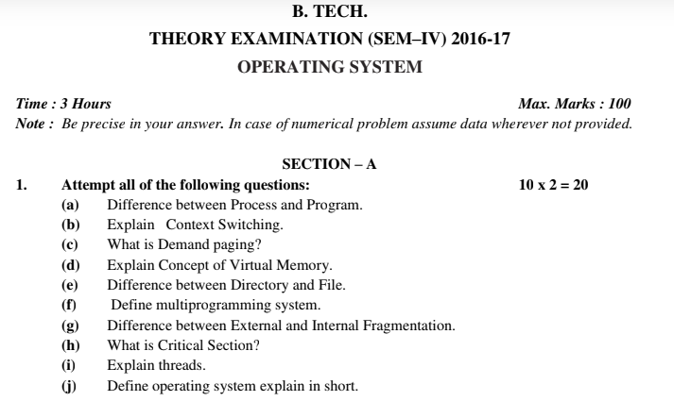
Old Question Papers
Aditya Narayan Singh ACSE0403A OS Unit-3

Slide 128
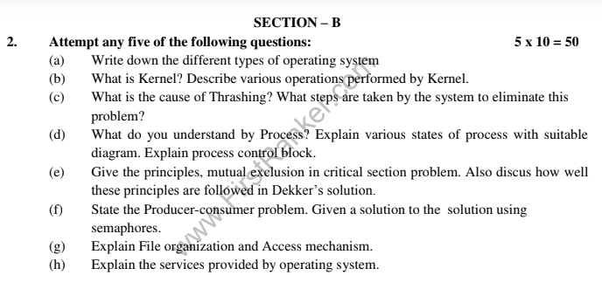
Old Question Papers
Aditya Narayan Singh ACSE0403A OS Unit-3
Operating System Concets

Slide 129
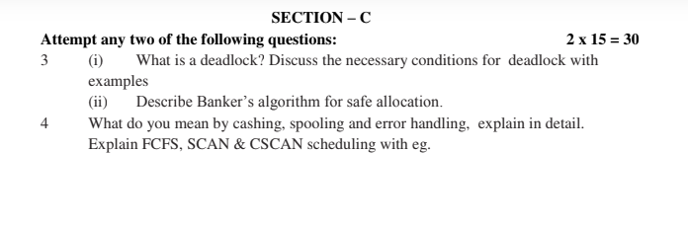
Old Question Papers
Aditya Narayan Singh ACSE0403A OS Unit-3
Operating System Concets

Slide 130
Expected Questions for University Exam
Define race condition.
Write and explain Peterson solution to the critical section problem.
Discuss product-consumer problem with semaphore.
Define critical section.
State the Readers/Writers problem with readers having higher priority. Give solution of the problem using semaphores.
Explain dinning philosopher problem & its solution.
Write a short note on inter-process communication with its advantages.
Define critical section.
Explain two primitive semaphore operations
Name some classic problem of synchronization
Aditya Narayan Singh ACSE0403A OS Unit-3
Operating System Concets

Slide 131
Expected Questions for University Exam
12. Write a note on Deadlock Prevention.
13. Write down the steps of Deadlock Detection
14. List out the necessary conditions for deadlock to occur.
Aditya Narayan Singh ACSE0403A OS Unit-3
Operating System Concets

Slide 132
Recap of Unit
In this module, we have studied the following:
Deadlocks
Deadlock Detection and Recovery
Cooperating process
Producer-Consumer Problem
Race condition
Critical Section
Peterson’s Solution
Classical Problems of Synchronization
Bounded-Buffer Problem
Readers and Writers Problem
Dining-Philosophers Problem
Problems with Semaphores
Inter-process Communication
Shared memory
Message passing
Aditya Narayan Singh ACSE0403A OS Unit-3
Operating System Concets

Slide 133
References
Books :
Silberschatz, Galvin and Gagne, “Operating Systems Concepts”, Wiley
SibsankarHalder and Alex A Aravind, “Operating Systems”, Pearson Education
Harvey M Dietel, “ An Introduction to Operating System”, Pearson Education
D M Dhamdhere, “Operating Systems : A Concept basedApproach”, McGraw Hill.
Charles Crowley, “Operating Systems: A Design-Oriented Approach”, Tata McGraw Hill Education”.
Stuart E. Madnick & John J. Donovan, “ Operating Systems”, Tata McGraw
Aditya Narayan Singh ACSE0403A OS Unit-3
Operating System Concets

Slide 134

Aditya Narayan Singh ACSE0403A OS Unit-3

